Slide 1
Capstone Project: analysis of Car accident severity
Bakhmutova Anastasia. October, 2020

Slide 2
Problem & Interest
There are many car accidents every day and every minute. Car accidents have always been terrible moments in people's lives, regardless of age. Each accident brings a strong surge of emotions among the participants. For the most part, these are negative emotions such as fear, sadness, anger.
There are many reasons that can cause a car accident.
We will limit ourselves to such external factors as inattention, being under the influence of drugs or alcohol, weather conditions and so on.
It is also worth considering where accidents occur most often and mark these places as the most dangerous.
And the degree of damage to the participants in the accident will let us understand the severity of the accident.
Analysis of data on accidents that have already occurred can help avoid future tragedies. The research results can be useful to both drivers and the state.

Slide 3
Data acquisition and cleaning
All the information with which the research was done was taken from the course of ‘Applied Data Science’ at Coursera site.
First, there were 2 columns that described the time of the accident. Therefore, it was decided to leave the attribute INCDATE as it could provide more information.
After analyzing, it became clear that there is a lack of data for 2019 and 2020. So our project is studied since 2005 to 2018.
Two more columns which describe similar things are SEVERITYCODE and SEVERITYDESC. It was decided to leave the description, because this is more useful for clarity.
As location is important for us, the rows of the table, where this data was empty, were deleted.
Since we set goals for ourselves, it turned out that some of the columns would not be useful in the future. Therefore, such columns have been removed.
After all, we get a table from177,774 samples and 29 features.

Slide 4
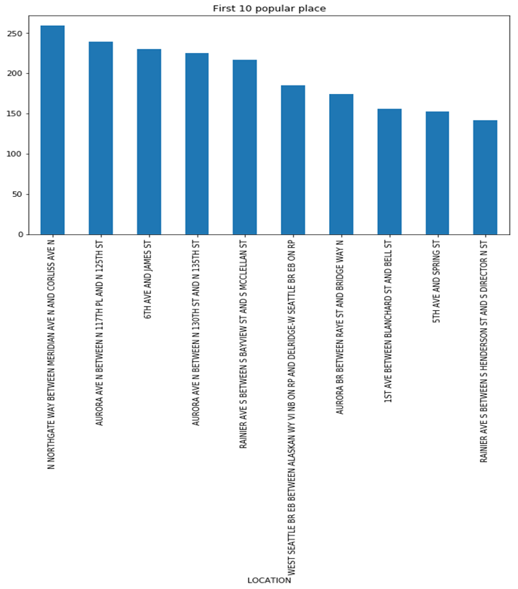
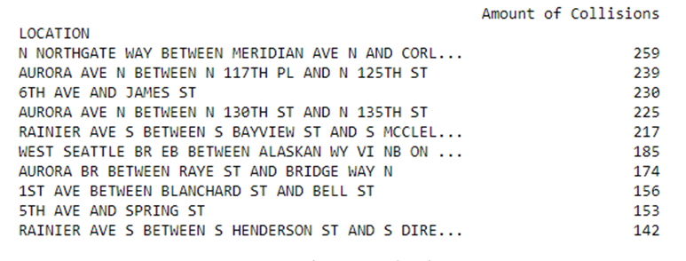
Analysis section: Location
Figure 2. Bar chart of the most popular locations
First of all, it was decided to identify the most common crash sites: it is logical to assume that these are also the most dangerous places to drive. It should be noted that we did not take out the places of car accidents, but only 10. In other cases, there were less than 100 accidents.
Figure 1. Table of the most popular locations

Slide 5
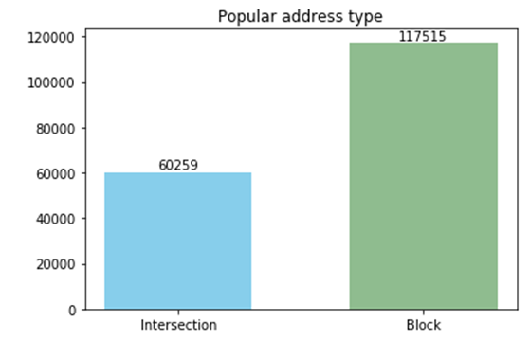
Analysis section: Location
In addition to the location of car accidents, we also considered the types of these places, i.e. whether these places are intersections, alleys or blocks. This analysis was accepted because the type of road section may affect driving conditions or the number of people involved in an accident.
Figure 3. Popular address type

Slide 6
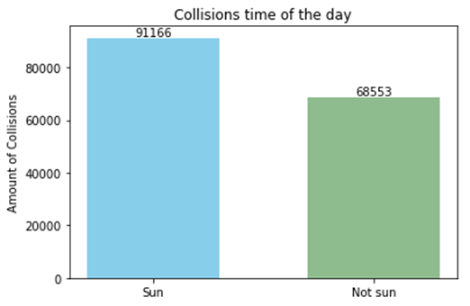
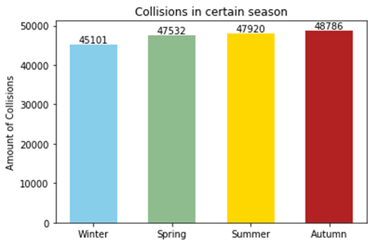
Analysis section: Time
Our next step is to consider the timing of accidents. Here we decided to divide all the time into 2 parts. The first group includes the time between the sunrise and sunset, the second group includes the rest. It has been found that in the United States of America the sun usually rises at 8 am and decreases at 6 pm.
Figure 4. Collisions time of the day
Also, the causes of accidents can be specific weather conditions that belong to a certain season of the year, so we decided to divide accidents into 4 groups according to the number of seasons.
Figure 5. Collisions in certain season

Slide 7
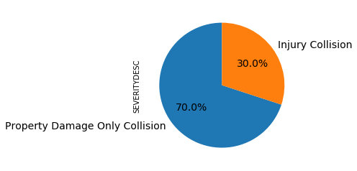
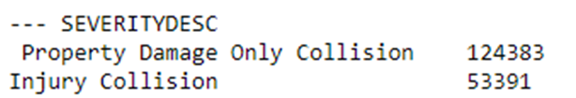
Analysis section: Severity
The consequences of accidents can be used to assess their severity. We made sure that the data for all accidents is known. Moreover, after conducting the analysis, we made sure that absolutely all the crashes occurred without serious injuries to the participants
Figure 6. Table of the severity of the collisions
Figure 7. Percentage of the severity

Slide 8
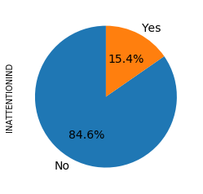
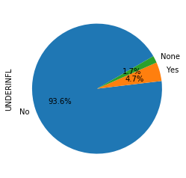
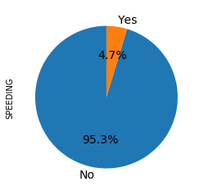
Analysis section: Reasons
For a clear understanding of what could have caused the car crash, we will consider all the columns of causes that are given in the original data. Putting the data in order, we performed some manipulations with the possible causes of car accidents and came to the following results:
For the most part, the drivers were attentive while driving;
More than 90% of drivers did not use drugs or alcohol;
- More than 95% of drivers did not exceed the legal speed;
Figure 8. Inattention
Figure 9. Influence of
drug or alcohol
Figure 10. Speeding

Slide 9
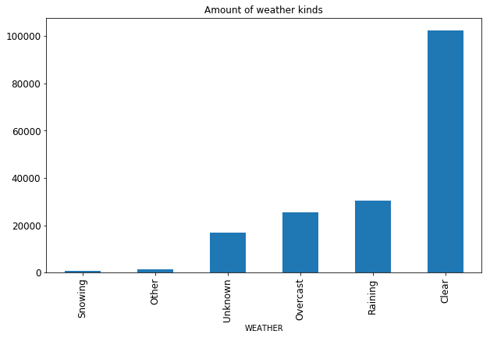
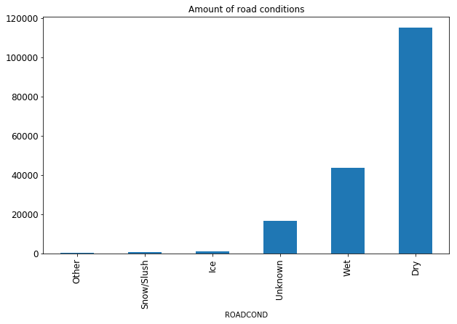
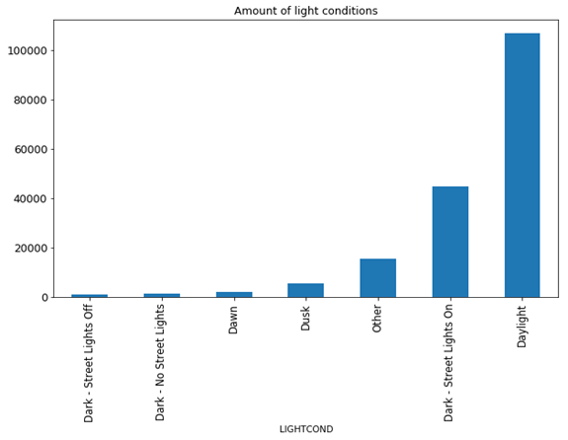
Analysis section: Reasons
It is worth noting that for the conditions of light, roads and weather, we marked the conditions that were encountered most of all, the rest we added to the "Other" category. This is done to make it easier to visualize and understand the data.
Figure 11. Bar chart of weather conditions
Figure 12. Bar chart of road conditions
Figure 13. Bar chart of light conditions

Slide 10
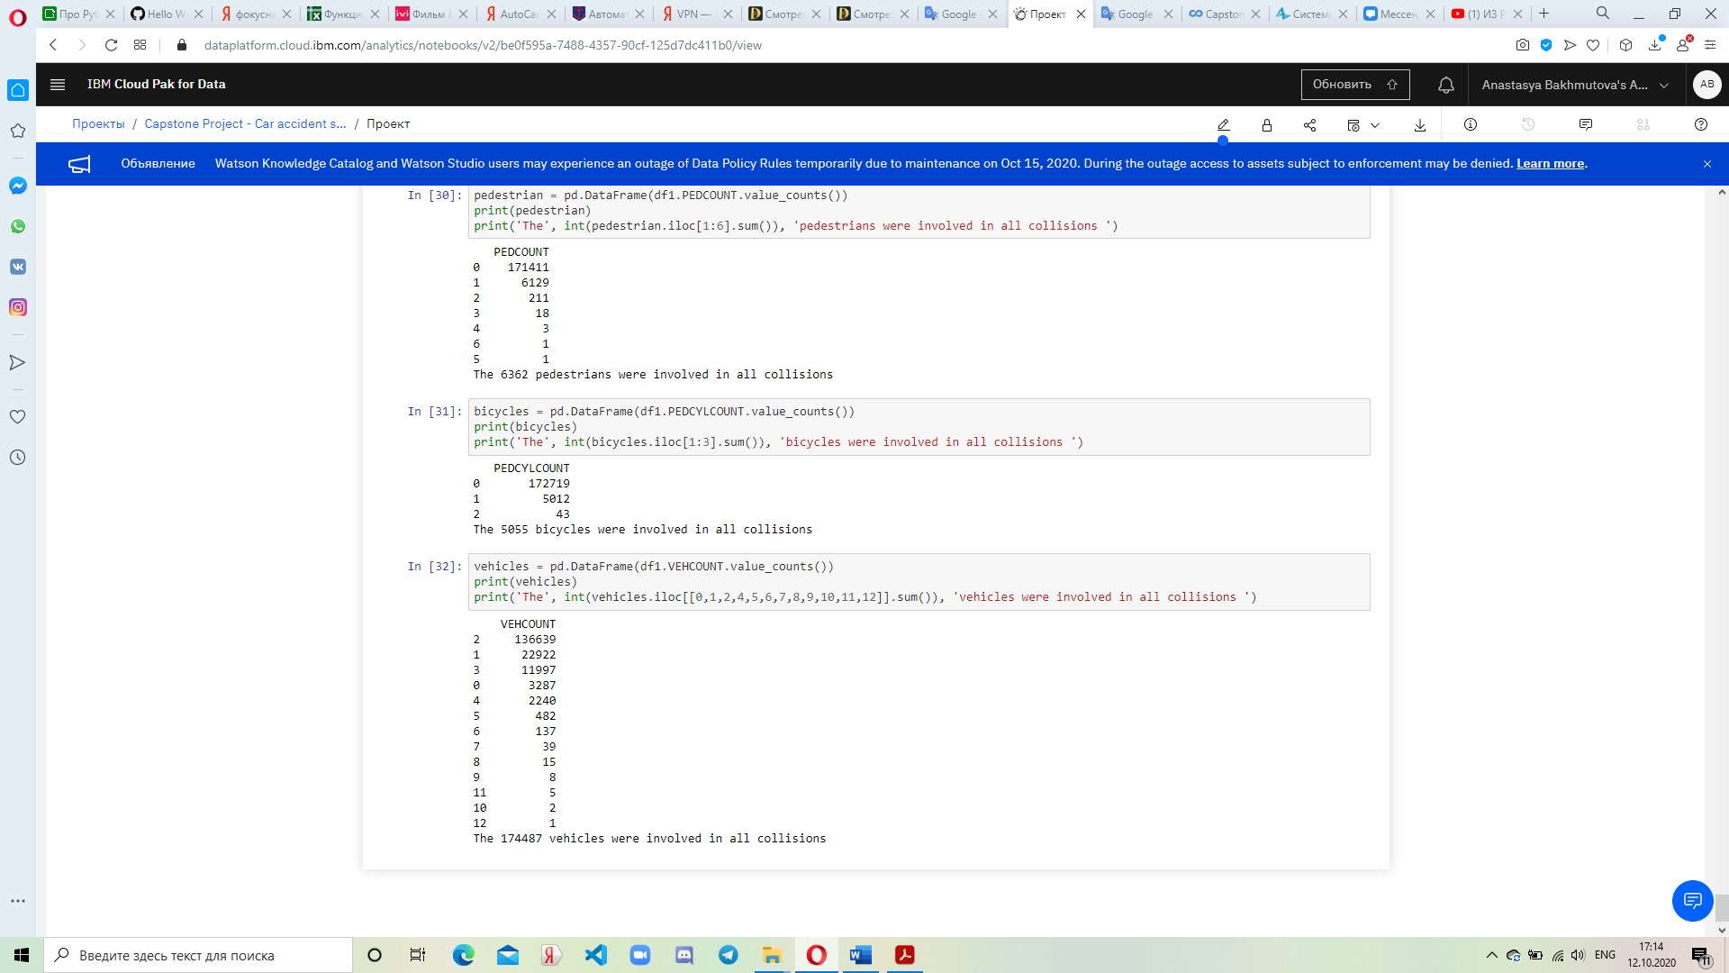
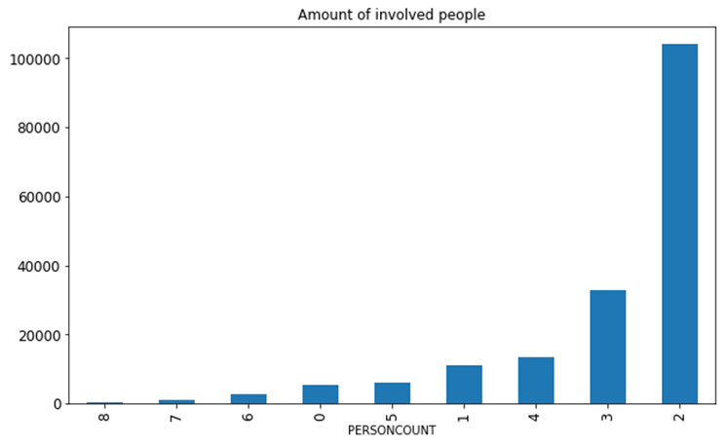
Analysis section:
Car accident participants
The last thing we noticed was the participants in the incident. This is important because each member of the accident had their own driving rules and characteristics of the movement of their vehicle.
Figure 15. Table of amount of involved pedestrians
Figure 17. Table of amount of involved vehicles
Figure 14. Amount of collisions with certain
number of involved people
Figure 16. Table of amount of involved bicycles

Slide 11
Results and Conclusions
We have the idea that most of the car accidents did not occur due to negative external influences or poor health of the drivers. The only unfavorable quality was the road, because it was wet, which could lead to uncontrolled sliding of the car.
All accidents did not have serious consequences for human health. All damage was caused by vehicles or surrounding inanimate objects.
There is also a trend in the number of participants present in the accident. In this way:
- the number of people involved in the accident is usually 2;
- most often 2 cars were involved in accidents;
- cyclists practically did not get into accidents;
- just like cyclists, pedestrians for the most part did not participate in incidents.

